Slide 1

Case Study on GINA (Global Innovation Network and Analysis)
By: Vinayak Jamadar(31137)

Slide 2
Contents
What is GINA?
GINA Lifecycle
Phase 1: Discovery
Phase 2: Data Preparation
Phase 3: Model Planning
Phase 4: Model Building
Phase 5: Communication Results
Phase 6: Operationalize

Slide 3
What is GINA?
Global Innovation Network and Analytics (GINA) team is a group of senior technologists located in centers of excellence (COEs) around the world.
This team's charter is to engage employees across global COEs to drive innovation, research, and university partnerships.
The GINA case study provides an example of how a team applied the Data Analytics Lifecycle to analyze innovation data at EMC.
Innovation is typically a difficult concept to measure, and this team wanted to look for ways to use advanced analytical methods to identify key innovators within the company.
The GINA team thought its approach would provide a means to share ideas globally and increase knowledge sharing among GINA members who may be separated geographically.

Slide 4
What is GINA? (Continued…)
It planned to create a data repository containing both structured and unstructured data to accomplish three main goals:
Store formal and informal data.
Track research from global technologists.
Mine the data for patterns and insights to improve the team's operations and strategy

Slide 5
GINA Lifecycle
Discovery
Data Preparation
Model Planning
Model Building
Communication Results
Operationalize

Slide 6
Phase 1: Discovery
In the GINA project's discovery phase, the team began identifying data sources.
The Various Roles are involved in this phase :
Business user, project sponsor, project manager: Vice President from Office of CTO
BI analyst: person from IT
Data engineer and DBA: people from IT
Data scientist: distinguished engineer

Slide 7
Phase 1: Discovery (Continued…)
The data for the project fell into two main categories:
Innovation Roadmap.
Data encompassed minutes and notes representing innovation and research activity from around the world.
The GINA (Hypothesis) can be grouped into two categories:
Descriptive analytics of what is currently happening to spark further creativity, collaboration, and asset generation.
Predictive analytics to advise executive management of where it should be investing in the future. Global Innovation Network.

Slide 8
Phase 2: Data Preparation
IT department to set up a new analytics sandbox to store and experiment on the data.
The data scientists and data engineers noticed that certain data needed conditioning and normalization.
As the team explored the data, it quickly realized that if it did not have data of sufficient quality or could not get good quality data, it would not be able to perform the subsequent steps in the lifecycle process.
Important to determine what level of data quality and cleanliness was sufficient for the project being undertaken.

Slide 9
Phase 3: Model Planning
The team made a decision to initiate a longitudinal study to begin tracking data points over time regarding people developing new intellectual property.
The parameters related to the scope of the study included the following considerations:
Identify the right milestones to achieve this goal.
Trace how people move ideas from each milestone toward the goal.
Once this is done, trace ideas that die, and trace others that reach the goal. Compare the journeys of ideas that make it and those that do not.
Compare the times and the outcomes using a few different methods (depending on how the data is collected and assembled). These could be as simple as t-tests or perhaps involve different types of classification algorithms.

Slide 10
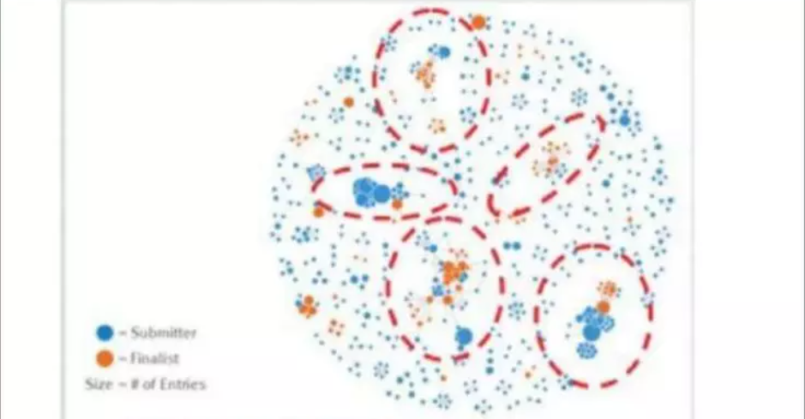
Phase 4: Model Building
The GINA team employed several analytical methods. This included work by the data scientist using Natural Language Processing (NLP) techniques on the textual descriptions of the Innovation Roadmap ideas.
Social network analysis using R and RStudio.

Slide 11
Phase 4: Model Building (Continued…)
Fig shows social graphs that portray the relationships between idea submitters within GINA.
Each colour represents an innovator from a different country.
The large dots with red circles around them represent hubs. A hub represents a person with high connectivity and a high “betweenness” score.
The team used Tableau software for data visualization and exploration and used the Pivotal Greenplum database as the main data repository and analytics engine.

Slide 12
Phase 5: Communication Results
This project was considered successful in identifying boundary spanners and hidden innovators.
The GINA project promoted knowledge sharing related to innovation and researchers spanning multiple areas within the company and outside of it.
GINA also enabled EMC to cultivate additional intellectual property that led to additional research topics and provided opportunities to forge relationships with universities for joint academic research in the fields of Data Science and Big Data.

Slide 13
Phase 5: Communication Results (Continued..)
Study was helpful in identifying hidden innovators:
Found high density of innovators in Cork, Highland.
The CTO office launched longitudinal studies to begin data collection efforts and track innovation results over long period of time.

Slide 14
Phase 6: Operationalize
Deployment was not really discussed.
Key findings:
1. Need more data in future.
2. Some data were sensitive.
3. A parallel initiative needs to be created to improve basic BI activities.
4. A mechanism is needed to continually re-evaluate the modal after deployment.

